Slide 1

Smart Policing System
MNNIT ALLAHABAD
Submitted By:
Sumit Paroothi
Shristi Jaiswal
Srikanth Karlapati
Uttej Cheedala
Banoth Akhil Naik

Slide 2
Quick Recap
An activity detection module was devised using computer vision techniques that can detect particular activities from CCTV footage in real time.
This module can be embedded within a communication system to make a completely autonomous policing system.
Algorithm for detecting only one activity(pedestrian detection) was implemented.

Slide 3
Objectives
The Proposed system aims to fulfill the following objectives:
Overcome limitations of traditional surveillance techniques which reuqire human vigilance.
Increase effectiveness of law enforcement authority by providing comprehensive information about any activity to the nearest police control room, reducing response time as well in the process.

Slide 4
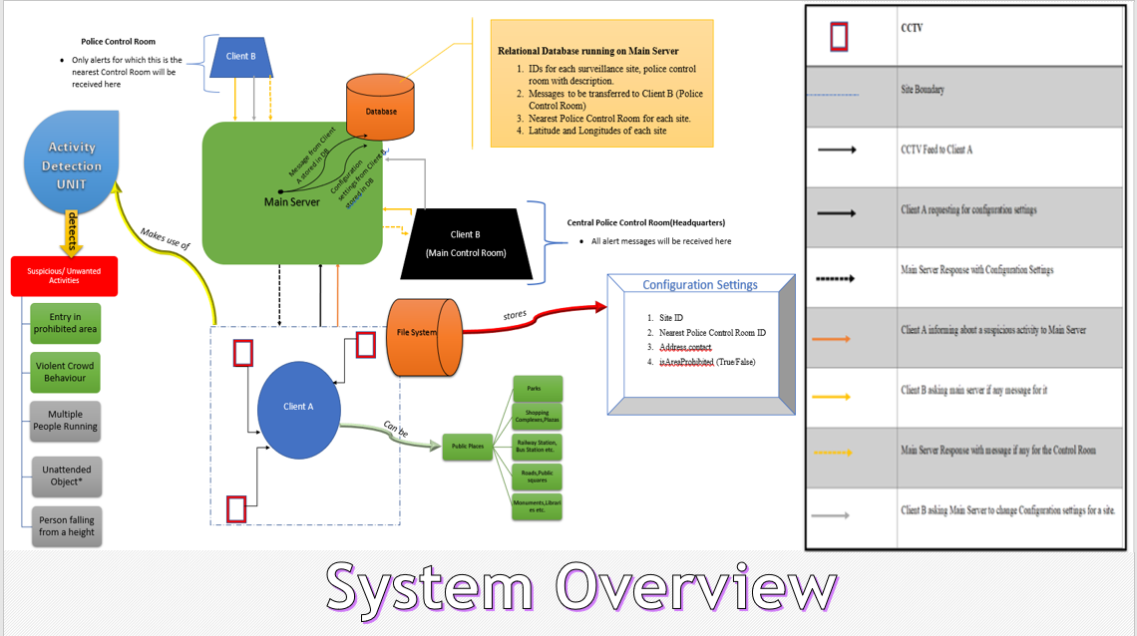

Slide 5
Detection of Violent Crowd Behavior
Monitor crowded events for outbreaks of violence
Given a video sequence S of frames (f1,f2,...), the goal is to classify S as Violent or Non Violent Activity.
Given a sequence of frames, S, we produce the VIolence Flows (ViF) descriptor.
We use simple linear support vector machines (SVM) as the underlying classifier.
Real-time violence detection is achieved by considering short frame sequences(15 frames), encoding each using its ViF descriptor and then immediately classifying it.

Slide 6
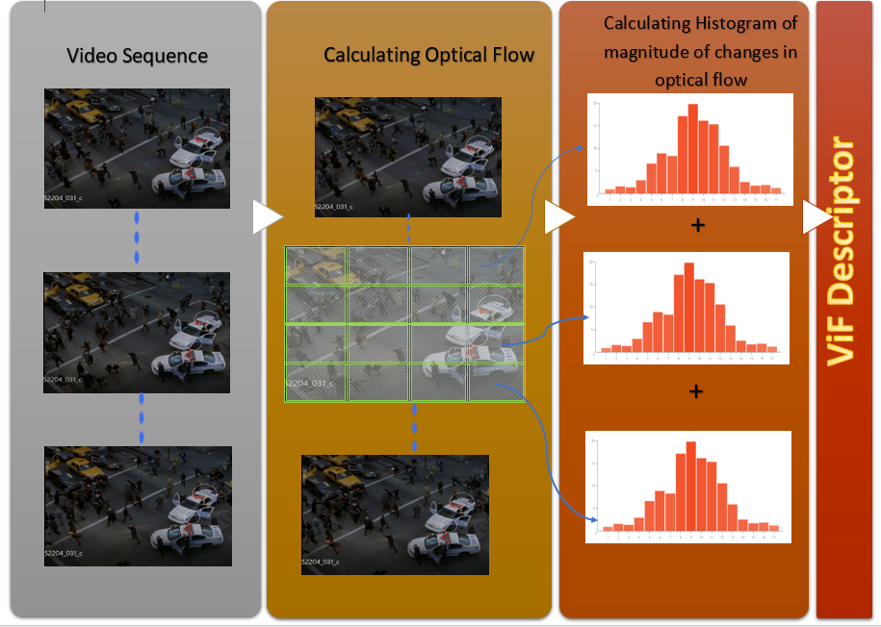
ViF Descriptor

Slide 7
Experiments and Analysis
A grid size of M*N=4*4 was used in the above algorithm.
To achieve real time performance 1 in every 3 frame sequences were processed. Each sequence of 15 frames(after sampling) is classified as violent or non-violent using SVM.
Violent-Flows database is an evaluation benchmark for crowd violence detection. There
are 246 videos in this database (123 violence and 123 non-violence).
The 246 videos are almost equally distributed in 5 parts, each part containing equal number of violent and non-violent videos randomly selected.The rest four sets are used for training and fifth is used for testing purposes.

Slide 8
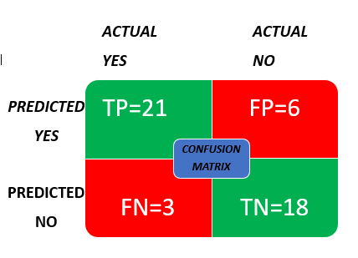
Analysis:
The accuracy achieved is good considering the
complex nature of crowd movements. Though an algorithm with higher accuracy would be needed for the purpose of our system.
2. It can be inferred that the ViF descriptor is unable to capture some important information.
3. Sensitivity is an important parameter in case of our system. We have laid more stress on increasing sensitivity as false positives can easily be ruled out using media evidence.
Accuracy = 81.25%
Sensitivity = 87.5%

Slide 9
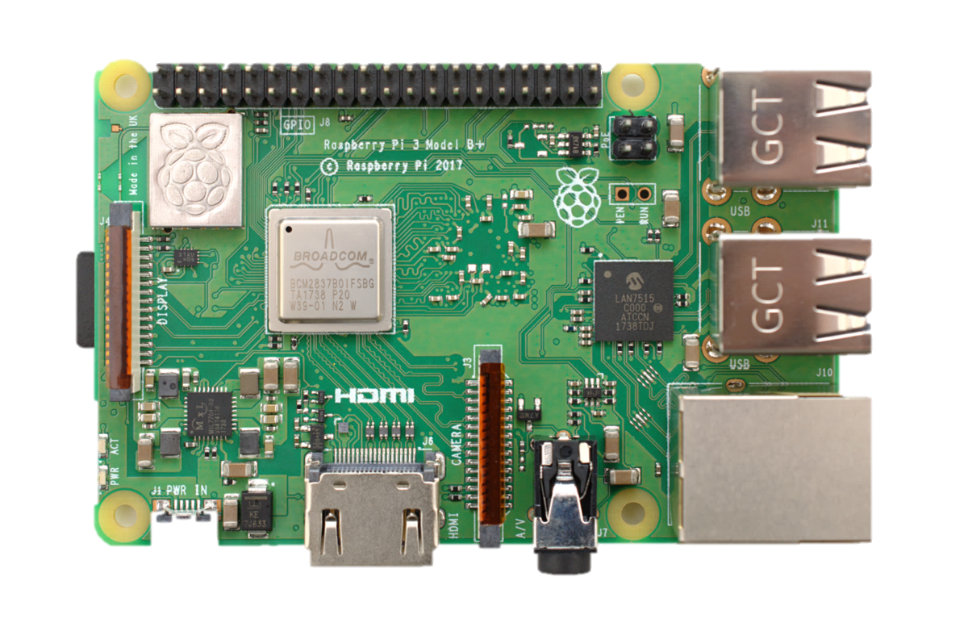
Raspberry Pi
The Raspberry Pi is a credit-card-sized computer that costs between 3000 and 5000 rupees. Its available anywhere in the world, and can function as a proper desktop computer or be used to build smart devices.
Reasons for choosing Raspberry Pi:
It is perfect for projects where you need a computer but do not require much processing power
It saves on space and keep the costs low
With the small footprint and electricity usage of the Pi, it is a perfect solution for an always on device All the above features make raspberry pi ideal for our application. x
We used Raspberry pi3 model B running on Raspian Stretch for the always-on device needed at surveillance site.

Slide 10
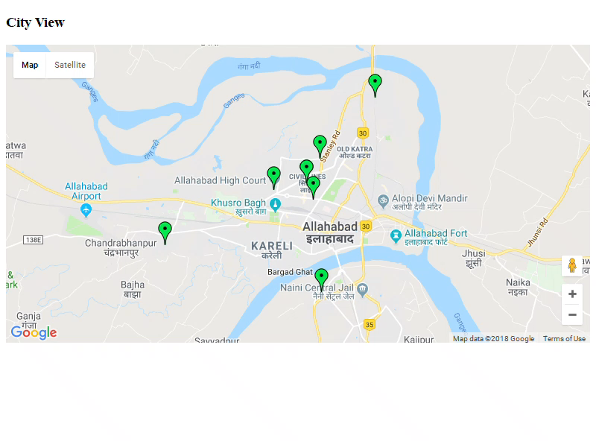
GUI – Complete System Monitoring

Slide 11
Deployment
The system will make use of existing CCTV infrastructure.
For development purposes Flasks inbuilt server has been used. It is highly recommended to use a real web server from reliable hosting service providers like AWS Elastic Beanstalk,Microsoft Azure.
Two feasible approaches have been chalked out for deployment at surveillance site. The choice of approach depends on the type of surveillance needed on site, number of cctvs and availability of resources.

Slide 12

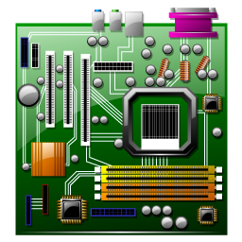

MAIN SERVER
MAIN SERVER
Video Processing
and communication
Video feed
Video Processing
and communication
Capture Video from different areas of the site
Single Board Computer e.g. Raspberry pi

Slide 13
References
M. Shah, O. Javed, K.Shafique,Automated Visual Surveillance in Realistic Scenarios, IEEE MultiMedia Vol. 14, Issue: 1, 2007
O. Javed, K. Shafique, and M. Shah, A Hierarchical Approach to Robust Background Subtraction Using Color and Gradient Information, Proc. IEEE Work shop on Motion and Video Computing, IEEE CS Press, 2002, pp. 22-27.
O. Javed ”Tracking across Multiple Cameras with Disjoint Views” 9th IEEE Int’l Conf. Computer Vision¡/em¿ pp. 343-357 2003.
R. Collins, A. Lipton, T. Kanade, ”Introduction to the Special Section on Video Surveillance”, IEEE Trans. Pattern Analysis and Machine Intelligence, vol. 22, no. 8, pp. 745, 2000.
Manohar Karki, Saikat Basu, Robert DiBiano, Supratik Mukhopadhyay, JerryWeltman, Malcolm Stagg, ”A symbolic framework for recognizing activities in full motion surveillance videos”, Computational Intelligence (SSCI) 2016 IEEE Symposium Series on, pp. 1-7, 2016.
N. Dalal, B. Triggs, Histograms of oriented gradients for human detection Computer Vision and Pattern Recognition, 2005. CVPR 2005. IEEE
C. Wren et al., Pfinder, Real-Time Tracking of the Human Body, IEEE Trans. Pattern Analysis and Machine Intelligence, vol. 19, no. 7, pp. 780-785.
J. Rehg, M. Loughlin, and K. Waters, Vision for a Smart Kiosk,

